Slide 1
Newton’s Method for Systems
An exploration of Math with
-Andrew Reisdorph
-Hunter Lang
-Timm Nygren

Slide 2
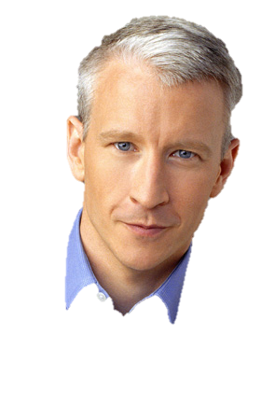
Newton’s Method for System s
Who was Isaac Newton?
What does his method do?
How does it work?
Why does it work?
Applications

Slide 3
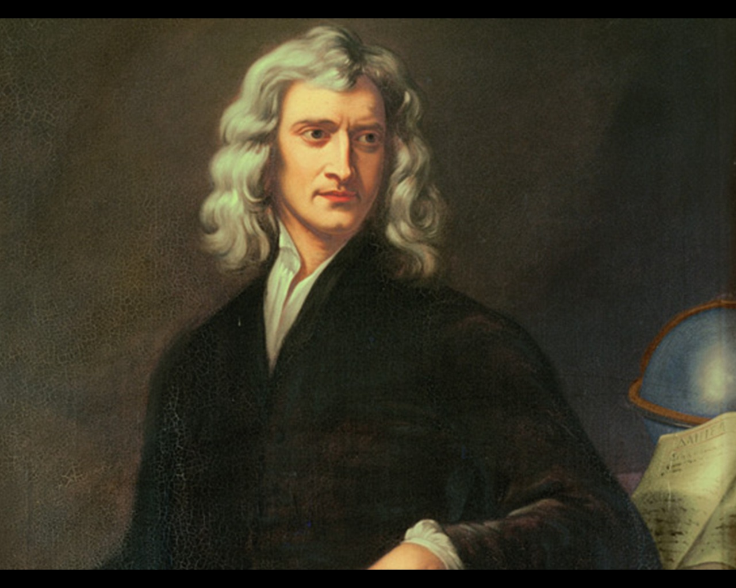
Isaac Newton was good at Math

Slide 4
What does Newton’s Method Do?

Slide 5
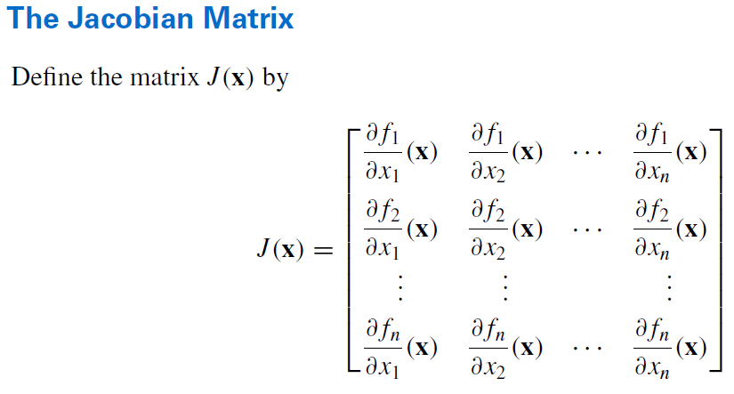
How does this Change for Systems?

Slide 6

Convergence
Quadratic except when:
Zero Derivative
Roots of multiplicity > 1
Other Issues

Slide 7
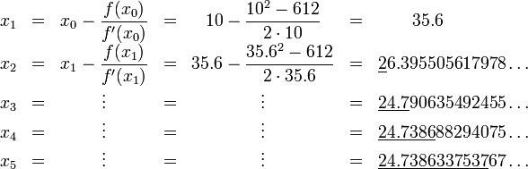
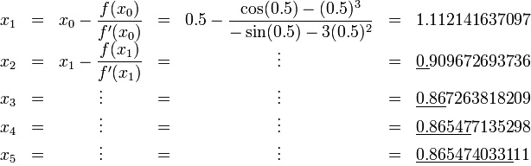

Applications
Finding the nth root of a number
$x^{2}=612$
Solutions to difficult equations:
$\cos\left(x\right)= x^{3}$

